Slide 1
Mining Frequent Patterns, Associations, and Correlations
Lectured by Shangsong Liang
Sun Yat-sen University
Notes:
https://academic.csuohio.edu/fuy/EEC%20525/index.html
From Jiawei Han www.cs.uiuc.edu/~hanj

Slide 2

Mining Frequent Patterns, Association and Correlations
Basic concepts and a road map
Efficient and scalable frequent itemset mining methods
Mining various kinds of association rules
From association mining to correlation analysis
Constraint-based association mining
Summary

Slide 3
What Is Frequent Pattern Analysis?
Frequent pattern: a pattern (a set of items, subsequences, substructures, etc.) that occurs frequently in a data set
First proposed by Agrawal, Imielinski, and Swami [AIS93] in the context of frequent itemsets and association rule mining
Motivation: Finding inherent regularities in data
  What products were often purchased together?— Beer and diapers?!
  What are the subsequent purchases after buying a PC?
  What kinds of DNA are sensitive to this new drug?
  Can we automatically classify web documents?
Applications
  Basket data analysis, cross-marketing, catalog design, sale campaign analysis, Web log (click stream) analysis, and DNA sequence analysis.

Slide 4
Why Is Freq. Pattern Mining Important?
Discloses an intrinsic and important property of data sets
Forms the foundation for many essential data mining tasks
  Association, correlation, and causality analysis
  Sequential, structural (e.g., sub-graph) patterns
  Pattern analysis in spatiotemporal, multimedia, time-series, and stream data
  Classification: associative classification
  Cluster analysis: frequent pattern-based clustering
  Data warehousing: iceberg cube and cube-gradient
  Semantic data compression: fascicles
  Broad applications

Slide 5
Basic Concepts: Frequent Patterns and Association Rules
Transaction-id | Items bought
10 | A, B, D
20 | A, C, D
30 | A, D, E
40 | B, E, F
50 | B, C, D, E, F
Itemset X = {x₁, …, x_{k}}
Find all the rules X → Y with minimum support and confidence
  support, s, probability that a transaction contains X ∪ Y
  confidence, c, conditional probability that a transaction having X also contains Y
Customer
buys both
Customer
buys diaper
Let sup_{min} = 50%, conf_{min} = 50%
Freq. Pat.: {A:3, B:3, D:4, E:3, AD:3}
Association rules:
  A → D (60%, 100%)
  D → A (60%, 75%)
Customer
buys beer

Slide 6
Closed Patterns and Max-Patterns
A long pattern contains a combinatorial number of sub-patterns, e.g., {a₁, …, a₁₀₀} contains (₁₀₀¹) + (₁₀₀²) + … + (₁¹₀⁰₀⁰) = 2¹⁰⁰ – 1 = 1.27*10³⁰ sub-patterns!
Solution: Mine closed patterns and max-patterns instead
An itemset X is closed if X is frequent and there exists no super-pattern Y כ X, with the same support as X (proposed by Pasquier, et al. @ ICDT’99)
An itemset X is a max-pattern if X is frequent and there exists no frequent super-pattern Y כ X (proposed by Bayardo @ SIGMOD’98)

Slide 7
Mining Frequent Patterns, Association and Correlations
Basic concepts and a road map
Efficient and scalable frequent itemset mining methods
Mining various kinds of association rules
From association mining to correlation analysis
Constraint-based association mining
Summary

Slide 8
Scalable Methods for Mining Frequent Patterns
The downward closure property of frequent patterns
  Any subset of a frequent itemset must be frequent
  If {beer, diaper, nuts} is frequent, so is {beer, diaper}
  i.e., every transaction having {beer, diaper, nuts} also contains {beer, diaper}
Scalable mining methods: Three major approaches
  Apriori (Agrawal & Srikant@VLDB’94)
  Freq. pattern growth (FPgrowth—Han, Pei & Yin @SIGMOD’00)
  Vertical data format approach (Charm—Zaki & Hsiao @SDM’02)

Slide 9
Apriori: A Candidate Generation-and-Test Approach
Apriori pruning principle: If there is any itemset which is infrequent, its superset should not be generated/tested! (Agrawal & Srikant @VLDB’94, Mannila, et al. @ KDD’ 94)
Method:
  Initially, scan DB once to get frequent 1-itemset
  Generate length (k+1) candidate itemsets from length k frequent itemsets
  Test the candidates against DB
  Terminate when no frequent or candidate set can be generated

Slide 10
The Apriori Algorithm—An Example
Sup_{min} = 2
Itemset | sup
{A} | 2
{B} | 3
{C} | 3
{D} | 1
{E} | 3
Database TDB
Itemset | sup
{A} | 2
{B} | 3
{C} | 3
{E} | 3
L₁
Tid | Items
10 | A, C, D
20 | B, C, E
30 | A, B, C, E
40 | B, E
C₁
1st scan
C₂
Itemset | sup
{A, B} | 1
{A, C} | 2
{A, E} | 1
{B, C} | 2
{B, E} | 3
{C, E} | 2
C₂
Itemset
{A, B}
{A, C}
{A, E}
{B, C}
{B, E}
{C, E}
L₂
Itemset | sup
{A, C} | 2
{B, C} | 2
{B, E} | 3
{C, E} | 2
2nd scan
C₃
Itemset
{B, C, E}
3rd scan
L₃
Itemset | sup
{B, C, E} | 2

Slide 11
The Apriori Algorithm
Pseudo-code:
    C_{k}: Candidate itemset of size k
    L_{k} : frequent itemset of size k
    L₁ = {frequent items};
    for (k = 1; L_{k} !=∅; k++) do begin
    C_{k+1} = candidates generated from L_{k};
    for each transaction t in database do
      increment the count of all candidates in C_{k+1} that are contained in t
    L_{k+1} = candidates in C_{k+1} with min_support
    end
    return ∪_{k} L_{k};

Slide 12
Important Details of Apriori
How to generate candidates?
  Step 1: self-joining L_{k}
  Step 2: pruning
How to count supports of candidates?
Example of Candidate-generation
  L₃={abc, abd, acd, ace, bcd}
  Self-joining: L₃*L₃
    abcd from abc and abd
    acde from acd and ace
  Pruning:
    acde is removed because ade is not in L₃
  C₄={abcd}

Slide 13
How to Count Supports of Candidates?
Why counting supports of candidates a problem?
  The total number of candidates can be very huge
  One transaction may contain many candidates
Method:
  Candidate itemsets are stored in a hash-tree
  Leaf node of hash-tree contains a list of itemsets and counts
  Interior node contains a hash table
  Subset function: finds all the candidates contained in a transaction

Slide 14
Efficient Implementation of Apriori in SQL
Hard to get good performance out of pure SQL (SQL-92) based approaches alone
Make use of object-relational extensions like UDFs, BLOBs, Table functions etc.
  Get orders of magnitude improvement
S. Sarawagi, S. Thomas, and R. Agrawal. Integrating association rule mining with relational database systems: Alternatives and implications. In SIGMOD’98

Slide 15
Challenges of Frequent Pattern Mining
Challenges
  Multiple scans of transaction database
  Huge number of candidates
  Tedious workload of support counting for candidates
Improving Apriori: general ideas
  Reduce passes of transaction database scans
  Shrink number of candidates
  Facilitate support counting of candidates

Slide 16
Partition: Scan Database Only Twice
Any itemset that is potentially frequent in DB must be frequent in at least one of the partitions of DB
  Scan 1: partition database and find local frequent patterns
  Scan 2: consolidate (合并) global frequent patterns
A. Savasere, E. Omiecinski, and S. Navathe. An efficient algorithm for mining association in large databases. In VLDB’95

Slide 17
DHP: Reduce the Number of Candidates
A k-itemset whose corresponding hashing bucket count is below the threshold cannot be frequent
  Candidates: a, b, c, d, e
  Hash entries: {ab, ad, ae} {bd, be, de} …
  Frequent 1-itemset: a, b, d, e
  ab is not a candidate 2-itemset if the sum of count of {ab, ad, ae} is below support threshold
J. Park, M. Chen, and P. Yu. An effective hash-based algorithm for mining association rules. In SIGMOD’95

Slide 18
Sampling for Frequent Patterns
Select a sample of original database, mine frequent patterns within sample using Apriori
Scan database once to verify frequent itemsets found in sample, only borders of closure of frequent patterns are checked
  Example: check abcd instead of ab, ac, …, etc.
Scan database again to find missed frequent patterns
H. Toivonen. Sampling large databases for association rules. In VLDB’96

Slide 19
DIC: Reduce Number of Scans
ABCD
Once both A and D are determined frequent, the counting of AD begins
Once all length-2 subsets of BCD are determined frequent, the counting of BCD begins
ABC
ABD
ACD
BCD
AB
AC
BC
AD
BD
CD
Transactions
1-itemsets
A
B
C
D
Apriori
2-itemsets
…
{}
Itemset lattice
1-itemsets
S. Brin R. Motwani, J. Ullman, and S. Tsur. Dynamic itemset counting and implication rules for market basket data. In SIGMOD’97
2-items
DIC
3-items

Slide 20
Bottleneck of Frequent-pattern Mining
Multiple database scans are costly
Mining long patterns needs many passes of scanning and generates lots of candidates
  To find frequent itemset i₁i₂…i₁₀₀
    # of scans: 100
    # of Candidates: (₁₀₀¹) + (₁₀₀²) + … + (₁¹₀⁰₀⁰) = 2¹⁰⁰-1 = 1.27*10³⁰ !
Bottleneck: candidate-generation-and-test
Can we avoid candidate generation?

Slide 21
Mining Frequent Patterns Without Candidate Generation
Grow long patterns from short ones using local frequent items
  “abc” is a frequent pattern
  Get all transactions having “abc”: DB|abc
  “d” is a local frequent item in DB|abc → abcd is a frequent pattern

Slide 22
Construct FP-tree from a Transaction Database
TID Items bought (ordered) frequent items
100 {f, a, c, d, g, i, m, p} {f, c, a, m, p}
200 {a, b, c, f, l, m, o} {f, c, a, b, m}
300 {b, f, h, j, o, w} {f, b}
400 {b, c, k, s, p} {c, b, p}
500 {a, f, c, e, l, p, m, n} {f, c, a, m, p}
min_support = 3
{}
Header Table
Item frequency head
f 4
c 4
a 3
b 3
m 3
p 3
Scan DB once, find frequent 1-itemset (single item pattern)
Sort frequent items in frequency descending order, f-list
Scan DB again, construct FP-tree
f:4
c:1
c:3
b:1
b:1
a:3
p:1
m:2
b:1
F-list=f-c-a-b-m-p
p:2
m:1

Slide 23
FP-Tree Definition (cont.)
Each node in the item prefix subtree consists of three fields:
  item-name
  node-link
  count
Each entry in the frequent-item header table consists of two fields:
  item-name
  head of node-link

Slide 24
Example 1: FP-Tree Construction
The transaction database used (first two column only):
minimum support threshold ξ= 3
TID | Items Bought | (Ordered) Frequent Items
100 | f, a, c, d, g, i, m, p | f, c, a, m, p
200 | a, b, c, f, l, m, o | f, c, a, b, m
300 | b, f, h, j, o | f, b
400 | b, c, k, s, p | c, b, p
500 | a, f, c, e, l, p, m, n | f, c, a, m, p

Slide 25
Example 1 (cont.)
First Scan: //count and sort
  count the frequencies of each item
  collect length-1 frequent items, then sort them in support descending order into L, frequent item list.
  L = {(f:4), (c:4), (a:3), (b:3), (m:3), (p:3)}

Slide 26
Example 1 (cont.)
Second Scan://create the tree and header table
  create the root, label it as “null”
  for each transaction Trans, do
    select and sort the frequent items in Trans
    increase nodes count or create new nodes
    If prefix nodes already exist, increase their counts by 1;
    If no prefix nodes, create it and set count to 1.
  build the item header table
    nodes with the same item-name are linked in sequence via node-links

Slide 27
Example 1 (cont.)
The building process of the tree
root
root
root
root
f : 1
f : 2
f : 3
c : 1
c : 2
c : 2
b : 1
a : 1
a : 2
a : 2
m : 1
m : 1
b : 1
m : 1
b : 1
p : 1
p : 1
m : 1
p : 1
m : 1
Create root
After trans 1 (f,c,a,m,p)
After trans 2 (f,c,a,b,m)
After trans 3 (f,b)

Slide 28
Example 1 (cont.)
The building process of the tree (cont.)
root
root
f : 3
c : 1
f : 4
c : 1
c : 2
b : 1
b : 1
c : 3
b : 1
b : 1
a : 2
p : 1
a : 3
p : 1
m : 1
b : 1
m : 2
b : 1
p : 1
m : 1
p : 2
m : 1
After trans 4 (c,b,p)
After trans 5 (f,c,a,m,p)

Slide 29
Example 1 (cont.)
Build the item header table
root
f : 4
c : 1
c : 3
b : 1
b : 1
Header Table
a : 3
p : 1
item
head of node-links
f
m : 2
b : 1
c
a
b
p : 2
m : 1
m
p

Slide 30
Benefits of the FP-tree Structure
Completeness
  Preserve complete information for frequent pattern mining
  Never break a long pattern of any transaction
Compactness
  Reduce irrelevant info—infrequent items are gone
  Items in frequency descending order: the more frequently occurring, the more likely to be shared
  Never be larger than the original database (not count node-links and the count field)

Slide 31
Partition Patterns and Databases
Frequent patterns can be partitioned into subsets according to f-list
  F-list=f-c-a-b-m-p
  Patterns containing p
  Patterns having m but no p
  …
  Patterns having c but no a nor b, m, p
  Pattern f
Completeness and non-redundency

Slide 32
Find Patterns Having P From P-conditional Database
Starting at the frequent item header table in the FP-tree
Traverse the FP-tree by following the link of each frequent item p
Accumulate all of transformed prefix paths of item p to form p’s conditional pattern base
{}
Header Table
Item frequency head
f 4
c 4
a 3
b 3
m 3
p 3
f:4
c:1
Conditional pattern bases
item cond. pattern base
c f:3
a fc:3
b fca:1, f:1, c:1
m fca:2, fcab:1
p fcam:2, cb:1
c:3
b:1
b:1
a:3
p:1
m:2
b:1
p:2
m:1

Slide 33
From Conditional Pattern-bases to Conditional FP-trees
For each pattern-base
  Accumulate the count for each item in the base
  Construct the FP-tree for the frequent items of the pattern base
m-conditional pattern base:
  fca:2, fcab:1
{}
Header Table
Item frequency head
f 4
c 4
a 3
b 3
m 3
p 3
f:4
c:1
All frequent patterns relate to m
m,
fm, cm, am,
fcm, fam, cam,
fcam
{}
c:3
b:1
b:1

f:3

a:3
p:1
m:2
b:1
c:3
p:2
m:1
a:3
m-conditional FP-tree

Slide 34
Recursion: Mining Each Conditional FP-tree
{}
{}
Cond. pattern base of “am”: (fc:3)
f:3
c:3
f:3
am-conditional FP-tree
c:3
{}
Cond. pattern base of “cm”: (f:3)
a:3
f:3
m-conditional FP-tree
cm-conditional FP-tree
{}
Cond. pattern base of “cam”: (f:3)
f:3
cam-conditional FP-tree

Slide 35
A Special Case: Single Prefix Path in FP-tree
Suppose a (conditional) FP-tree T has a shared single prefix-path P
Mining can be decomposed into two parts
  Reduction of the single prefix path into one node
  Concatenation of the mining results of the two parts
{}
a₁:n₁
a₂:n₂
a₃:n₃
{}
r₁
b₁:m₁
C₁:k₁
a₁:n₁
+

r₁
=
b₁:m₁
C₁:k₁
a₂:n₂
C₂:k₂
C₃:k₃
a₃:n₃
C₂:k₂
C₃:k₃

Slide 36
Mining Frequent Patterns With FP-trees
Idea: Frequent pattern growth
  Recursively grow frequent patterns by pattern and database partition
Method
  For each frequent item, construct its conditional pattern-base, and then its conditional FP-tree
  Repeat the process on each newly created conditional FP-tree
  Until the resulting FP-tree is empty, or it contains only one path—single path will generate all the combinations of its sub-paths, each of which is a frequent pattern

Slide 37
Scaling FP-growth by DB Projection
FP-tree cannot fit in memory?—DB projection
First partition a database into a set of projected DBs
Then construct and mine FP-tree for each projected DB
Parallel projection vs. Partition projection techniques
  Parallel projection is space costly

Slide 38
Partition-based Projection
Parallel projection needs a lot of disk space
Partition projection saves it
Tran. DB
fcamp
fcabm
fb
cbp
fcamp
p-proj DB
fcam
cb
fcam
m-proj DB
fcab
fca
fca
b-proj DB
f
cb
…
a-proj DB
fc
…
c-proj DB
f
…
f-proj DB
…
am-proj DB
fc
fc
fc
cm-proj DB
f
f
f
…

Slide 39
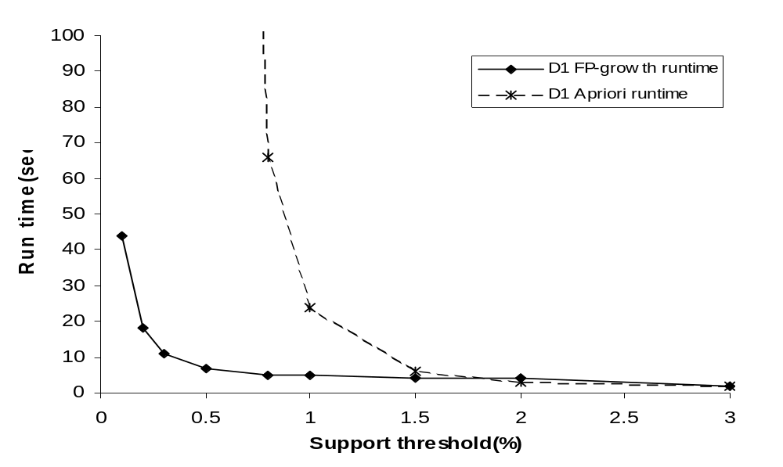
FP-Growth vs. Apriori: Scalability With the Support Threshold
Data set T25I20D10K

Slide 40
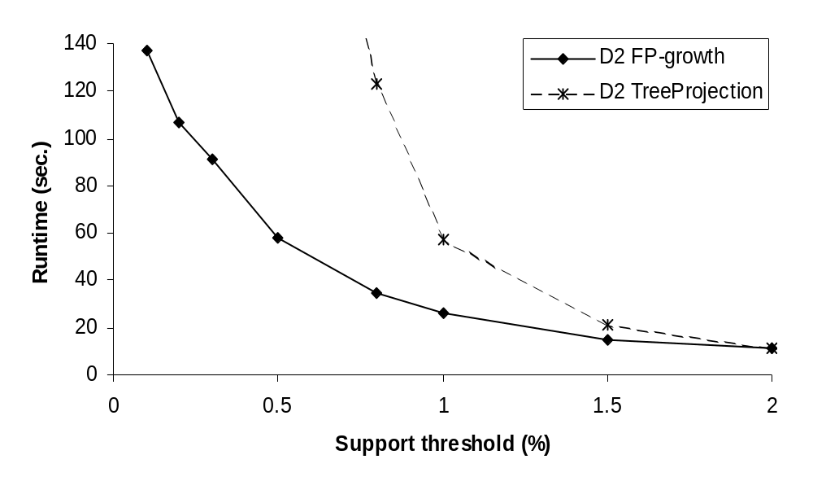
FP-Growth vs. Tree-Projection: Scalability with the Support Threshold
Data set T25I20D100K

Slide 41
Why Is FP-Growth the Winner?
Divide-and-conquer:
  decompose both the mining task and DB according to the frequent patterns obtained so far
  leads to focused search of smaller databases
Other factors
  no candidate generation, no candidate test
  compressed database: FP-tree structure
  no repeated scan of entire database
  basic ops—counting local freq items and building sub FP-tree, no pattern search and matching

Slide 42
Implications of the Methodology
Mining closed frequent itemsets and max-patterns
  CLOSET (DMKD’00)
Mining sequential patterns
  FreeSpan (KDD’00), PrefixSpan (ICDE’01)
Constraint-based mining of frequent patterns
  Convertible constraints (KDD’00, ICDE’01)
Computing iceberg data cubes with complex measures
  H-tree and H-cubing algorithm (SIGMOD’01)

Slide 43
MaxMiner: Mining Max-patterns
1st scan: find frequent items
  A, B, C, D, E
2nd scan: find support for
  AB, AC, AD, AE, ABCDE
  BC, BD, BE, BCDE
  CD, CE, CDE, DE,
Since BCDE is a max-pattern, no need to check BCD, BDE, CDE in later scan
R. Bayardo. Efficiently mining long patterns from databases. In SIGMOD’98
Tid | Items
10 | A,B,C,D,E
20 | B,C,D,E,
30 | A,C,D,F
Potential max-patterns

Slide 44
Mining Frequent Closed Patterns: CLOSET
Flist: list of all frequent items in support ascending order
  Flist: d-a-f-e-c
Divide search space
  Patterns having d
  Patterns having d but no a, etc.
Find frequent closed pattern recursively
  Every transaction having d also has cfa → cfad is a frequent closed pattern
J. Pei, J. Han & R. Mao. CLOSET: An Efficient Algorithm for Mining Frequent Closed Itemsets", DMKD'00.
Min_sup=2
TID | Items
10 | a, c, d, e, f
20 | a, b, e
30 | c, e, f
40 | a, c, d, f
50 | c, e, f

Slide 45
CLOSET+: Mining Closed Itemsets by Pattern-Growth
Itemset merging: if Y appears in every occurrence of X, then Y is merged with X
Sub-itemset pruning: if Y כ X, and sup(X) = sup(Y), X and all of X’s descendants in the set enumeration tree can be pruned
Hybrid tree projection
  Bottom-up physical tree-projection
  Top-down pseudo tree-projection
Item skipping: if a local frequent item has the same support in several header tables at different levels, one can prune it from the header table at higher levels
Efficient subset checking

Slide 46
CHARM: Mining by Exploring Vertical Data Format
Vertical format: t(AB) = {T₁₁, T₂₅, …}
  tid-list: list of trans.-ids containing an itemset
Deriving closed patterns based on vertical intersections
  t(X) = t(Y): X and Y always happen together
  t(X) ⊂ t(Y): transaction having X always has Y
Using diffset to accelerate mining
  Only keep track of differences of tids
  t(X) = {T₁, T₂, T₃}, t(XY) = {T₁, T₃}
  Diffset (XY, X) = {T₂}
Eclat/MaxEclat (Zaki et al. @KDD’97), VIPER(P. Shenoy et al.@SIGMOD’00), CHARM (Zaki & Hsiao@SDM’02)

Slide 47
Further Improvements of Mining Methods
AFOPT (Liu, et al. @ KDD’03)
  A “push-right” method for mining condensed frequent pattern (CFP) tree
Carpenter (Pan, et al. @ KDD’03)
  Mine data sets with small rows but numerous columns
  Construct a row-enumeration tree for efficient mining

Slide 48
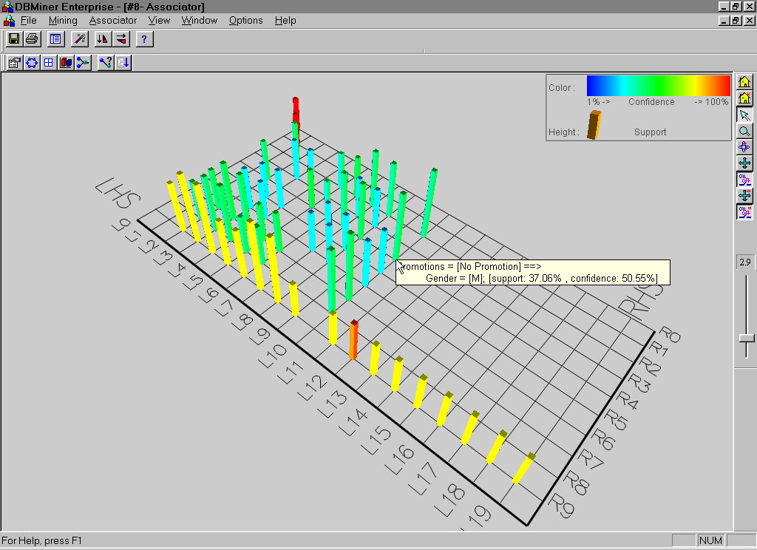
Visualization of Association Rules: Plane Graph

Slide 49
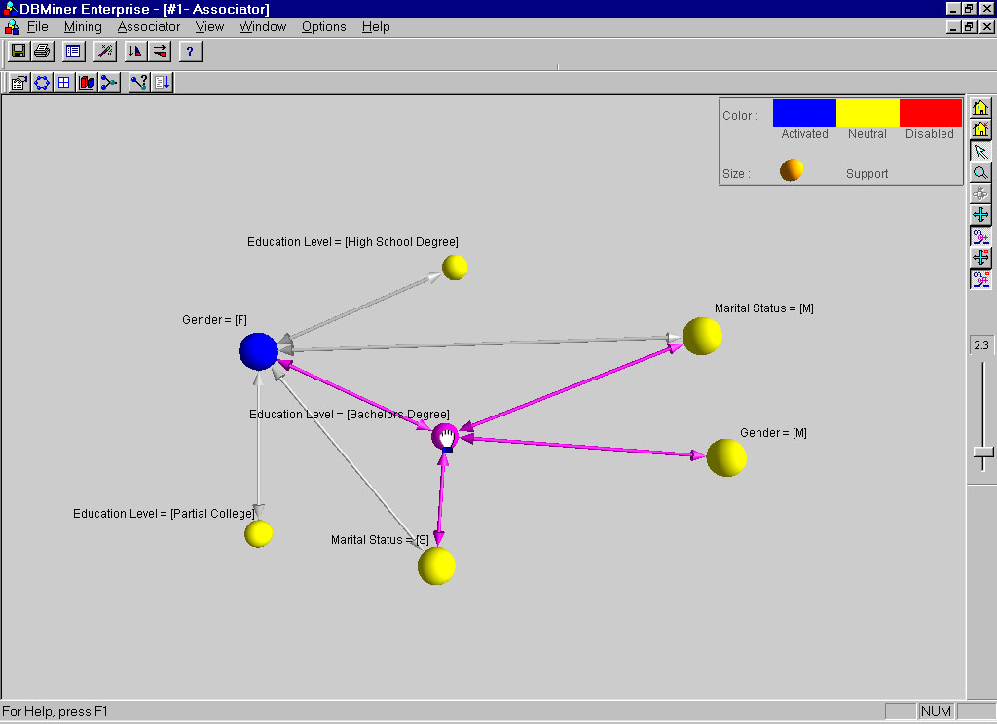
Visualization of Association Rules: Rule Graph

Slide 50
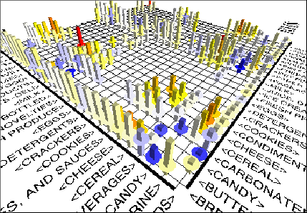
Visualization of Association Rules
(SGI/MineSet 3.0)

Slide 51
Mining Frequent Patterns, Association and Correlations
Basic concepts and a road map
Efficient and scalable frequent itemset mining methods
Mining various kinds of association rules
From association mining to correlation analysis
Constraint-based association mining
Summary

Slide 52
Mining Various Kinds of Association Rules
Mining multilevel association
Miming multidimensional association
Mining quantitative association
Mining interesting correlation patterns

Slide 53
Mining Multiple-Level Association Rules
Items often form hierarchies
Flexible support settings
  Items at the lower level are expected to have lower support
Exploration of shared multi-level mining (Agrawal & Srikant@VLB’95, Han & Fu@VLDB’95)
uniform support
reduced support
Level 1
min_sup = 5%
Milk
[support = 10%]
Level 1
min_sup = 5%
Level 2
min_sup = 5%
2% Milk
[support = 6%]
Skim Milk
[support = 4%]
Level 2
min_sup = 3%

Slide 54
Multi-level Association: Redundancy Filtering
Some rules may be redundant due to “ancestor” relationships between items.
Example
  milk ⇒ wheat bread [support = 8%, confidence = 70%]
  2% milk ⇒ wheat bread [support = 2%, confidence = 72%]
We say the first rule is an ancestor of the second rule.
A rule is redundant if its support is close to the “expected” value, based on the rule’s ancestor.

Slide 55
Mining Multi-Dimensional Association
Single-dimensional rules:
    buys(X, “milk”) ⇒ buys(X, “bread”)
Multi-dimensional rules: ≥ 2 dimensions or predicates
  Inter-dimension assoc. rules (no repeated predicates)
    age(X,”19-25”) ∧ occupation(X,“student”) ⇒ buys(X, “coke”)
  hybrid-dimension assoc. rules (repeated predicates)
    age(X,”19-25”) ∧ buys(X, “popcorn”) ⇒ buys(X, “coke”)
Categorical Attributes: finite number of possible values, no ordering among values—data cube approach
Quantitative Attributes: numeric, implicit ordering among values—discretization, clustering, and gradient approaches

Slide 56
Mining Quantitative Associations
Techniques can be categorized by how numerical attributes, such as age or salary are treated
Static discretization based on predefined concept hierarchies (data cube methods)
Dynamic discretization based on data distribution (quantitative rules, e.g., Agrawal & Srikant@SIGMOD96)
Clustering: Distance-based association (e.g., Yang & Miller@SIGMOD97)
  one dimensional clustering then association
Deviation: (such as Aumann and Lindell@KDD99)
  Sex = female => Wage: mean=$7/hr (overall mean = $9)

Slide 57
Static Discretization of Quantitative Attributes
Discretized prior to mining using concept hierarchy.
Numeric values are replaced by ranges.
In relational database, finding all frequent k-predicate sets will require k or k+1 table scans.
Data cube is well suited for mining.
The cells of an n-dimensional
  cuboid correspond to the
  predicate sets.
Mining from data cubes
can be much faster.
()
(age)
(income)
(buys)
(age, income)
(age,buys)
(income,buys)
(age,income,buys)

Slide 58
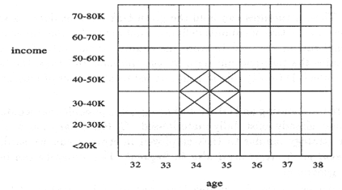
Quantitative Association Rules
Proposed by Lent, Swami and Widom ICDE’97
Numeric attributes are dynamically discretized
  Such that the confidence or compactness of the rules mined is maximized
2-D quantitative association rules: A_{quan1} ∧ A_{quan2} ⇒ A_{cat}
Cluster adjacent association rules to form general rules using a 2-D grid
Example
age(X,”34-35”) ∧ income(X,”30-50K”)
⇒ buys(X,”high resolution TV”)

Slide 59
Mining Other Interesting Patterns
Flexible support constraints (Wang et al. @ VLDB’02)
  Some items (e.g., diamond) may occur rarely but are valuable
  Customized sup_{min} specification and application
Top-K closed frequent patterns (Han, et al. @ ICDM’02)
  Hard to specify sup_{min}, but top-k with length_{min} is more desirable
  Dynamically raise sup_{min} in FP-tree construction and mining, and select most promising path to mine

Slide 60
Mining Frequent Patterns, Association and Correlations
Basic concepts and a road map
Efficient and scalable frequent itemset mining methods
Mining various kinds of association rules
From association mining to correlation analysis
Constraint-based association mining
Summary

Slide 61
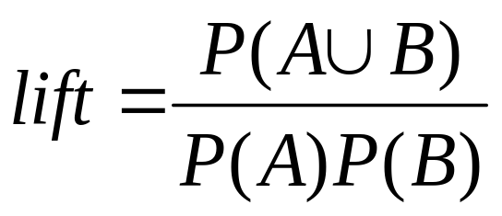
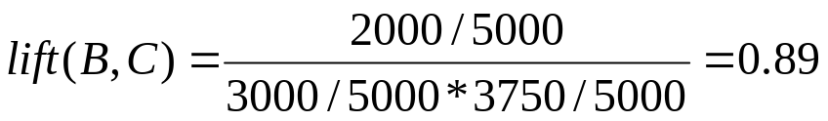
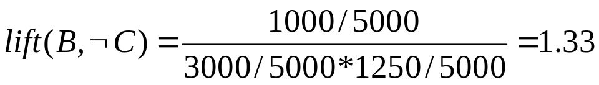
Interestingness Measure: Correlations (Lift)
play basketball ⇒ eat cereal [40%, 66.7%] is misleading
  The overall % of students eating cereal is 75% > 66.7%.
play basketball ⇒ not eat cereal [20%, 33.3%] is more accurate, although with lower support and confidence
Measure of dependent/correlated events: lift
 | Basketball | Not basketball | Sum (row)
Cereal | 2000 | 1750 | 3750
Not cereal | 1000 | 250 | 1250
Sum(col.) | 3000 | 2000 | 5000

Slide 62
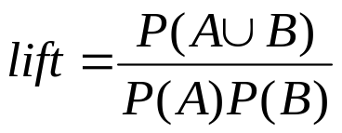
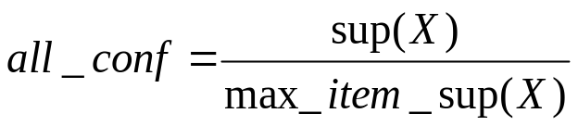
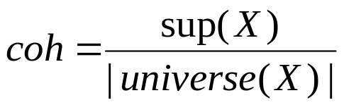
Are lift and χ² Good Measures of Correlation?
“Buy walnuts ⇒ buy milk [1%, 80%]” is misleading
  if 85% of customers buy milk
Support and confidence are not good to represent correlations
So many interestingness measures? (Tan, Kumar, Sritastava @KDD’02)
 | Milk | No Milk | Sum (row)
Coffee | m, c | ~m, c | c
No Coffee | m, ~c | ~m, ~c | ~c
Sum(col.) | m | ~m | Σ
DB | m, c | ~m, c | m~c | ~m~c | lift | all-conf | coh | χ2
A1 | 1000 | 100 | 100 | 10,000 | 9.26 | 0.91 | 0.83 | 9055
A2 | 100 | 1000 | 1000 | 100,000 | 8.44 | 0.09 | 0.05 | 670
A3 | 1000 | 100 | 10000 | 100,000 | 9.18 | 0.09 | 0.09 | 8172
A4 | 1000 | 1000 | 1000 | 1000 | 1 | 0.5 | 0.33 | 0

Slide 63
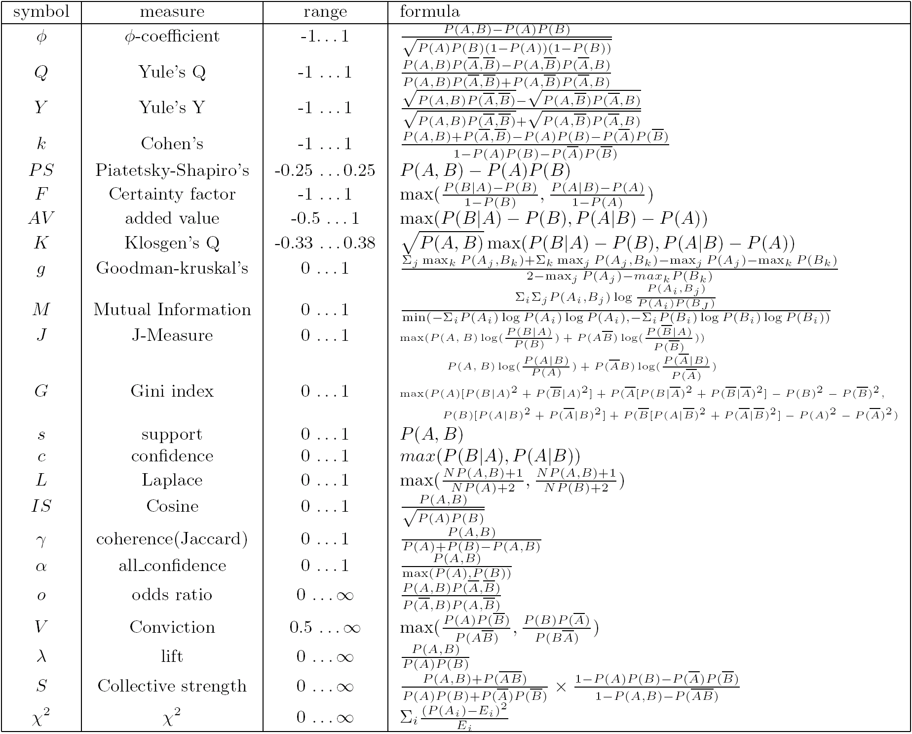
Which Measures Should Be Used?
lift and χ² are not good measures for correlations in large transactional DBs
all-conf or coherence could be good measures (Omiecinski@TKDE’03)
Both all-conf and coherence have the downward closure property
Efficient algorithms can be derived for mining (Lee et al. @ICDM’03sub)

Slide 64
Mining Frequent Patterns, Association and Correlations
Basic concepts and a road map
Efficient and scalable frequent itemset mining methods
Mining various kinds of association rules
From association mining to correlation analysis
Constraint-based association mining
Summary

Slide 65
Constraint-based (Query-Directed) Mining
Finding all the patterns in a database autonomously? — unrealistic!
  The patterns could be too many but not focused!
Data mining should be an interactive process
  User directs what to be mined using a data mining query language (or a graphical user interface)
Constraint-based mining
  User flexibility: provides constraints on what to be mined
  System optimization: explores such constraints for efficient mining—constraint-based mining

Slide 66
Constraints in Data Mining
Knowledge type constraint:
  classification, association, etc.
Data constraint — using SQL-like queries
  find product pairs sold together in stores in Chicago in Dec.’02
Dimension/level constraint
  in relevance to region, price, brand, customer category
Rule (or pattern) constraint
  small sales (price < $10) triggers big sales (sum > $200)
Interestingness constraint
  strong rules: min_support ≥ 3%, min_confidence ≥ 60%

Slide 67
Constrained Mining vs. Constraint-Based Search
Constrained mining vs. constraint-based search/reasoning
  Both are aimed at reducing search space
  Finding all patterns satisfying constraints vs. finding some (or one) answer in constraint-based search in AI
  Constraint-pushing vs. heuristic search
  It is an interesting research problem on how to integrate them
Constrained mining vs. query processing in DBMS
  Database query processing requires to find all
  Constrained pattern mining shares a similar philosophy as pushing selections deeply in query processing

Slide 68
Anti-Monotonicity in Constraint Pushing
TDB (min_sup=2)
Anti-monotonicity
  When an intemset S violates the constraint, so does any of its superset
  sum(S.Price) ≤ v is anti-monotone
  sum(S.Price) ≥ v is not anti-monotone
Example. C: range(S.profit) ≤ 15 is anti-monotone
  Itemset ab violates C
  So does every superset of ab
TID | Transaction
10 | a, b, c, d, f
20 | b, c, d, f, g, h
30 | a, c, d, e, f
40 | c, e, f, g
Item | Profit
a | 40
b | 0
c | -20
d | 10
e | -30
f | 30
g | 20
h | -10

Slide 69
Monotonicity for Constraint Pushing
TDB (min_sup=2)
Monotonicity
  When an intemset S satisfies the constraint, so does any of its superset
  sum(S.Price) ≥ v is monotone
  min(S.Price) ≤ v is monotone
Example. C: range(S.profit) ≥ 15
  Itemset ab satisfies C
  So does every superset of ab
TID | Transaction
10 | a, b, c, d, f
20 | b, c, d, f, g, h
30 | a, c, d, e, f
40 | c, e, f, g
Item | Profit
a | 40
b | 0
c | -20
d | 10
e | -30
f | 30
g | 20
h | -10

Slide 70
Succinctness
Succinctness:
  Given A_{1,} the set of items satisfying a succinctness constraint C, then any set S satisfying C is based on A₁ , i.e., S contains a subset belonging to A₁
  Idea: Without looking at the transaction database, whether an itemset S satisfies constraint C can be determined based on the selection of items
  min(S.Price) ≤ v is succinct
  sum(S.Price) ≥ v is not succinct
Optimization: If C is succinct, C is pre-counting pushable

Slide 71
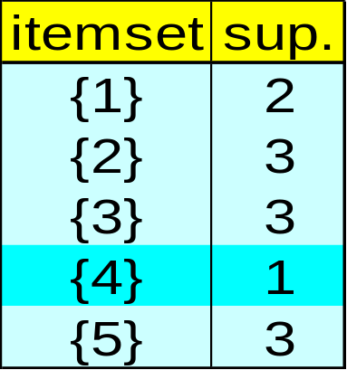
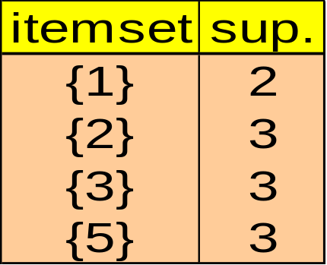
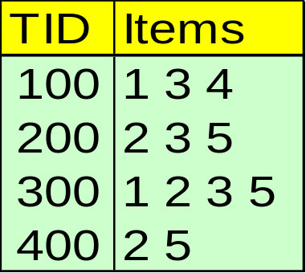
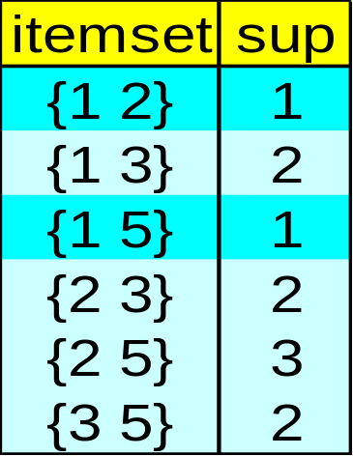
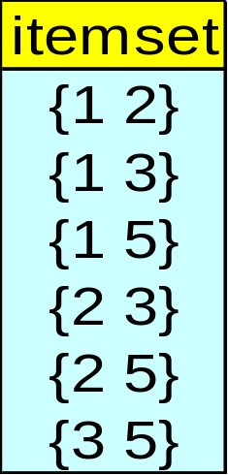
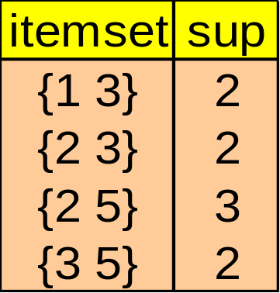
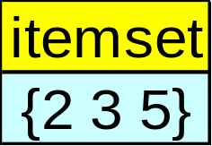
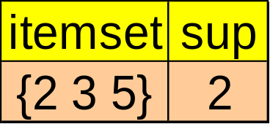
The Apriori Algorithm — Example
Database D
L₁
C₁
Scan D
C₂
C₂
L₂
Scan D
C₃
Scan D
L₃

Slide 72
Naïve Algorithm: Apriori + Constraint
Database D
L₁
C₁
Scan D
C₂
C₂
L₂
Scan D
C₃
Scan D
L₃
Constraint:
Sum{S.price} < 5

Slide 73
The Constrained Apriori Algorithm: Push an Anti-monotone Constraint Deep
Database D
L₁
C₁
Scan D
C₂
C₂
L₂
Scan D
C₃
Scan D
L₃
Constraint:
Sum{S.price} < 5

Slide 74
The Constrained Apriori Algorithm: Push a Succinct Constraint Deep
Database D
L₁
C₁
Scan D
C₂
C₂
L₂
Scan D
not immediately
to be used
C₃
Scan D
L₃
Constraint:
min{S.price } <= 1

Slide 75
Converting “Tough” Constraints
TDB (min_sup=2)
Convert tough constraints into anti-monotone or monotone by properly ordering items
Examine C: avg(S.profit) ≥ 25
  Order items in value-descending order
    <a, f, g, d, b, h, c, e>
  If an itemset afb violates C
    So does afbh, afb*
    It becomes anti-monotone!
TID | Transaction
10 | a, b, c, d, f
20 | b, c, d, f, g, h
30 | a, c, d, e, f
40 | c, e, f, g
Item | Profit
a | 40
b | 0
c | -20
d | 10
e | -30
f | 30
g | 20
h | -10

Slide 76
Strongly Convertible Constraints
avg(X) ≥ 25 is convertible anti-monotone w.r.t. item value descending order R: <a, f, g, d, b, h, c, e>
  If an itemset af violates a constraint C, so does every itemset with af as prefix, such as afd
avg(X) ≥ 25 is convertible monotone w.r.t. item value ascending order R⁻¹: <e, c, h, b, d, g, f, a>
  If an itemset d satisfies a constraint C, so does itemsets df and dfa, which having d as a prefix
Thus, avg(X) ≥ 25 is strongly convertible
Item | Profit
a | 40
b | 0
c | -20
d | 10
e | -30
f | 30
g | 20
h | -10

Slide 77
Can Apriori Handle Convertible Constraint?
A convertible, not monotone nor anti-monotone nor succinct constraint cannot be pushed deep into the an Apriori mining algorithm
  Within the level wise framework, no direct pruning based on the constraint can be made
  Itemset df violates constraint C: avg(X)>=25
  Since adf satisfies C, Apriori needs df to assemble adf, df cannot be pruned
But it can be pushed into frequent-pattern growth framework!
Item | Value
a | 40
b | 0
c | -20
d | 10
e | -30
f | 30
g | 20
h | -10

Slide 78
Mining With Convertible Constraints
Item | Value
a | 40
f | 30
g | 20
d | 10
b | 0
h | -10
c | -20
e | -30
C: avg(X) >= 25, min_sup=2
List items in every transaction in value descending order R: <a, f, g, d, b, h, c, e>
  C is convertible anti-monotone w.r.t. R
Scan TDB once
  remove infrequent items
    Item h is dropped
  Itemsets a and f are good, …
Projection-based mining
  Imposing an appropriate order on item projection
  Many tough constraints can be converted into (anti)-monotone
TDB (min_sup=2)
TID | Transaction
10 | a, f, d, b, c
20 | f, g, d, b, c
30 | a, f, d, c, e
40 | f, g, h, c, e

Slide 79
Handling Multiple Constraints
Different constraints may require different or even conflicting item-ordering
If there exists an order R s.t. both C₁ and C₂ are convertible w.r.t. R, then there is no conflict between the two convertible constraints
If there exists conflict on order of items
  Try to satisfy one constraint first
  Then using the order for the other constraint to mine frequent itemsets in the corresponding projected database

Slide 80
What Constraints Are Convertible?
Constraint | Convertible anti-monotone | Convertible monotone | Strongly convertible
avg(S) ≤ , ≥ v | Yes | Yes | Yes
median(S) ≤ , ≥ v | Yes | Yes | Yes
sum(S) ≤ v (items could be of any value, v ≥ 0) | Yes | No | No
sum(S) ≤ v (items could be of any value, v ≤ 0) | No | Yes | No
sum(S) ≥ v (items could be of any value, v ≥ 0) | No | Yes | No
sum(S) ≥ v (items could be of any value, v ≤ 0) | Yes | No | No
……

Slide 81
Constraint-Based Mining—A General Picture
Constraint | Antimonotone | Monotone | Succinct
v ∈ S | no | yes | yes
S ⊇ V | no | yes | yes
S ⊆ V | yes | no | yes
min(S) ≤ v | no | yes | yes
min(S) ≥ v | yes | no | yes
max(S) ≤ v | yes | no | yes
max(S) ≥ v | no | yes | yes
count(S) ≤ v | yes | no | weakly
count(S) ≥ v | no | yes | weakly
sum(S) ≤ v ( a ∈ S, a ≥ 0 ) | yes | no | no
sum(S) ≥ v ( a ∈ S, a ≥ 0 ) | no | yes | no
range(S) ≤ v | yes | no | no
range(S) ≥ v | no | yes | no
avg(S) θ v, θ ∈ { =, ≤, ≥ } | convertible | convertible | no
support(S) ≥ ξ | yes | no | no
support(S) ≤ ξ | no | yes | no

Slide 82
A Classification of Constraints
Monotone
Antimonotone
Strongly
convertible
Succinct
Convertible
anti-monotone
Convertible
monotone
Inconvertible

Slide 83
Chapter 5: Mining Frequent Patterns, Association and Correlations
Basic concepts and a road map
Efficient and scalable frequent itemset mining methods
Mining various kinds of association rules
From association mining to correlation analysis
Constraint-based association mining
Summary

Slide 84
Frequent-Pattern Mining: Summary
Frequent pattern mining—an important task in data mining
Scalable frequent pattern mining methods
  Apriori (Candidate generation & test)
  Projection-based (FPgrowth, CLOSET+, ...)
  Vertical format approach (CHARM, ...)
Mining a variety of rules and interesting patterns
Constraint-based mining
Mining sequential and structured patterns
Extensions and applications

Slide 85
Frequent-Pattern Mining: Research Problems
Mining fault-tolerant frequent, sequential and structured patterns
  Patterns allows limited faults (insertion, deletion, mutation)
Mining truly interesting patterns
  Surprising, novel, concise, …
Application exploration
  E.g., DNA sequence analysis and bio-pattern classification
  “Invisible” data mining

Slide 86
Ref: Basic Concepts of Frequent Pattern Mining
(Association Rules) R. Agrawal, T. Imielinski, and A. Swami. Mining association rules between sets of items in large databases. SIGMOD'93.
(Max-pattern) R. J. Bayardo. Efficiently mining long patterns from databases. SIGMOD'98.
(Closed-pattern) N. Pasquier, Y. Bastide, R. Taouil, and L. Lakhal. Discovering frequent closed itemsets for association rules. ICDT'99.
(Sequential pattern) R. Agrawal and R. Srikant. Mining sequential patterns. ICDE'95

